Slide 1
Vehicle

Slide 2
Introduction
The PhysX Vehicle SDK models vehicles as collections of sprung masses
where each sprung mass represents a suspension line with associated wheel and tire data
These collections of sprung masses have a complementary representation as a rigid body actor whose mass, center of mass, and moment of inertia matches exactly the masses and coordinates of the sprung masses

Slide 3
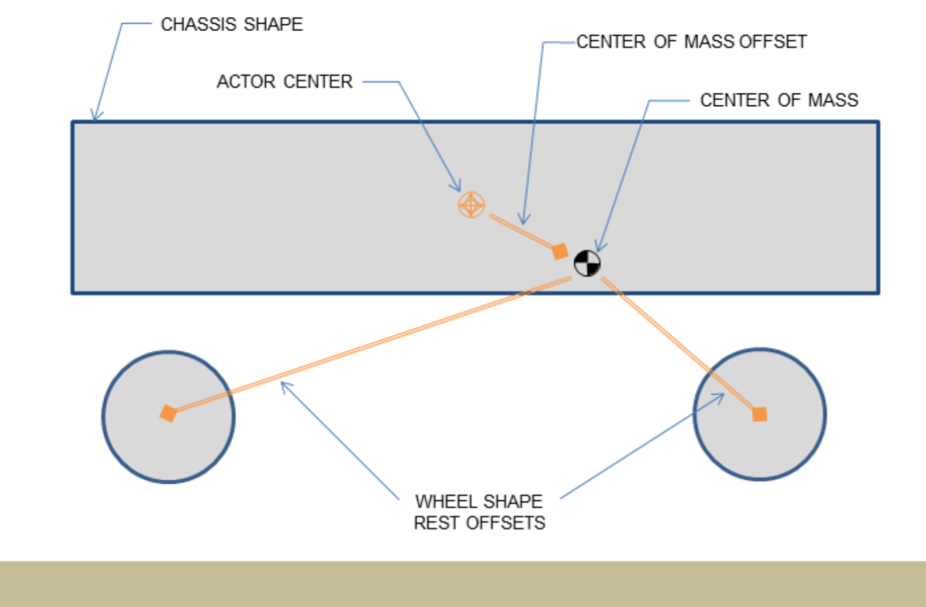
Vehicle representation as a rigid body actor with shapes for the chassis and wheels. Note that the wheel rest offsets are specified relative to the center of mass.

Slide 4
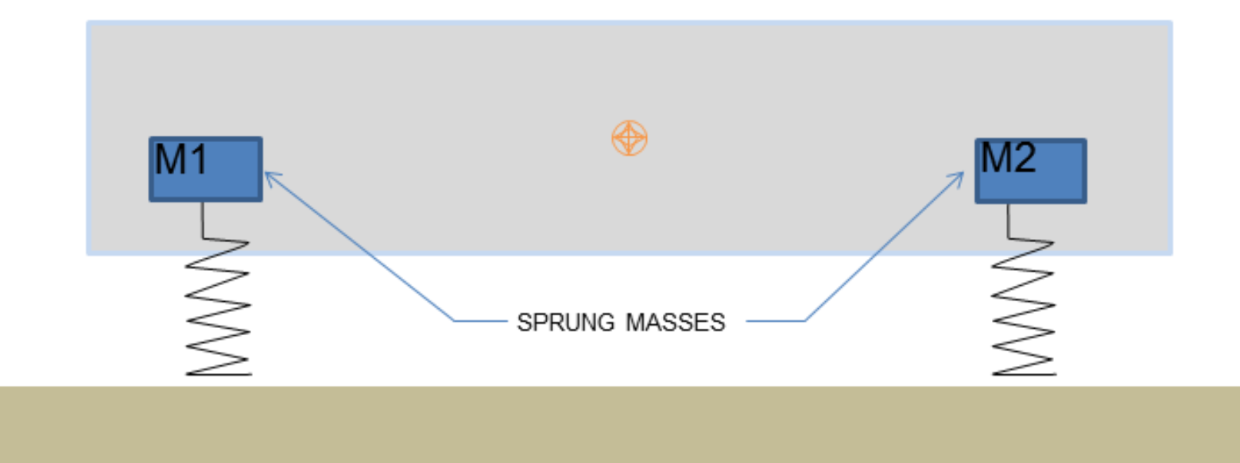
Vehicle representation as a collection of sprung masses of mass M1 and M2.

Slide 5
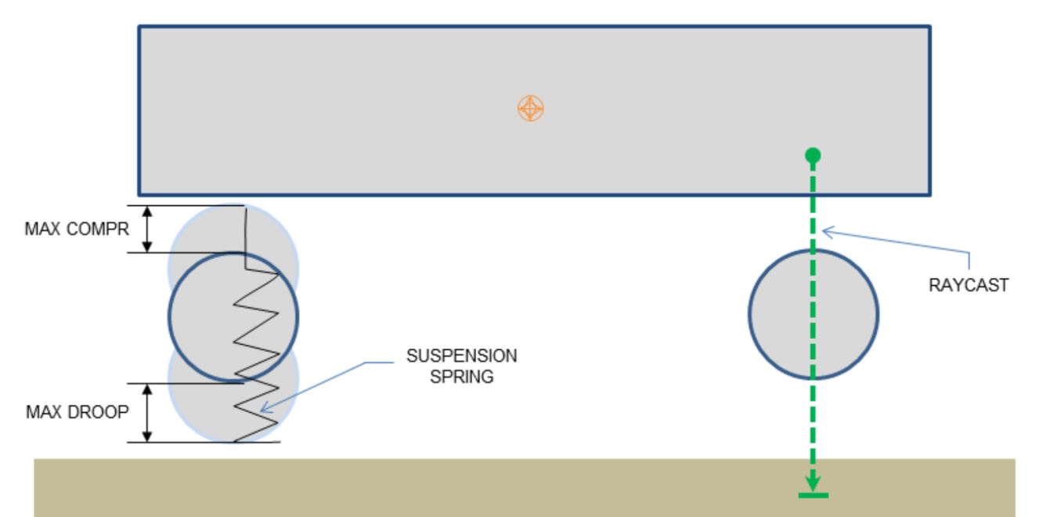
The update of each vehicle begins with a raycast for each suspension line. The raycast starts just above the the top of the tire at maximum compression and casts downwards along the direction of suspension travel to a position just below the bottom of the tire at maximum droop

Slide 6
Vehicle SDK Initialization
Before using the vehicle SDK it must first be initialized in order to set up a number of threshold values from various tolerance scales. This is as straightforward as calling the following function:
PX_C_EXPORT bool PX_CALL_CONV PxInitVehicleSDK (PxPhysics& physics, PxSerializationRegistry* serializationRegistry = NULL);

Slide 7
The basis vectors of the vehicle simulation must also be configured so that longitudinal and lateral tire slips may be unambiguously computed:
void PxVehicleSetBasisVectors(const PxVec3& up, const PxVec3& forward);

Slide 8
The rigid body actors associated with vehicles can be updated either immediately with velocity modifications or updated with an acceleration that is applied in the next PhysX SDK simulate call. The following function can be used to select the required update mode:
void PxVehicleSetUpdateMode(PxVehicleUpdateMode::Enum vehicleUpdateMode);

Slide 9
the vehicle SDK also has a shutdown process which needs to be invoked:
PX_C_EXPORT void PX_CALL_CONV PxCloseVehicleSDK (PxSerializationRegistry* serializationRegistry = NULL);

Slide 10
As an illustration of the usage of these functions, SnippetVehicle4W has the following initialization code:
PxInitVehicleSDK(*gPhysics);
PxVehicleSetBasisVectors(PxVec3(0,1,0), PxVec3(0,0,1)); PxVehicleSetUpdateMode(PxVehicleUpdateMode::eVELOCITY_CHANGE);

Slide 11
Introduction To Vehicle Creation
const PxU32 numWheels = 4;
PxVehicleWheelsSimData* wheelsSimData = PxVehicleWheelsSimData::allocate(numWheels);
setupWheelsSimulationData(wheelsSimData);
PxVehicleDriveSimData4W driveSimData;
setupDriveSimData(driveSimData);
PxRigidDynamic* vehActor = myPhysics.createRigidDynamic(startPose);
setupVehicleActor(vehActor);
myScene.addActor(*vehActor);
PxVehicleDrive4W* vehDrive4W = PxVehicleDrive4W::allocate(numWheels);
vehDrive4W->setup(physics, veh4WActor, *wheelsSimData, driveSimData, numWheels - 4);
wheelsSimData->free();

Slide 12
Introduction To Vehicle Update
The PhysX Vehicles SDK utilizes batched scene queries to query the geometry under each tire. A more detailed discussion of PhysX batched scene queries can be found in Section Batched queries.
The following pseudo-code initializes a batched scene query with buffers large enough for a single vehicle with four wheels:

Slide 13
PxRaycastQueryResult sqResults[4];
PxRaycastHit sqHitBuffer[4];
PxBatchQueryDesc sqDesc(4, 0, 0);
sqDesc.queryMemory.userRaycastResultBuffer = sqResults;
sqDesc.queryMemory.userRaycastTouchBuffer = sqHitBuffer;
sqDesc.queryMemory.raycastTouchBufferSize = 4;
sqDesc.preFilterShader = myFilterShader;
PxBatchQuery* batchQuery = scene->createBatchQuery(sqDesc);

Slide 14
PhysX vehicles make use of scene query filter shaders to eliminate intersections with the vehicle issuing the raycast and with any geometry that is not to be considered as a drivable surface

Slide 15
For a batch containing just a single 4-wheeled vehicle the suspension raycasts can be performed with the following pseudo-code:
PxVehicleWheels* vehicles[1] = {myVehicle};
PxVehicleSuspensionRaycasts(batchQuery, 1, vehicles, 4, sqResults);

Slide 16
The vehicles are updated with the following function call:
The function PxVehicleUpdates updates the internal dynamics of each vehicle, poses the wheel shapes of the vehicle's actor and applies either velocity or acceleration changes to the actor, depending on the update mode chosen with PxVehicleSetUpdateMode
PxVehicleUpdates(timestep, gravity, frictionPairs, 1, vehicles, NULL);

Slide 17
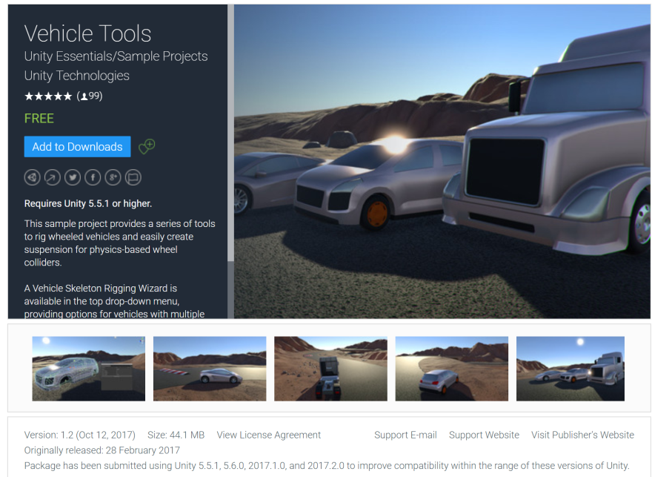
Vehicle in Unity
https://www.assetstore.unity3d.com/en/#!/content/83660

